Slide 1
Vietnam War BackgrounD

Slide 2
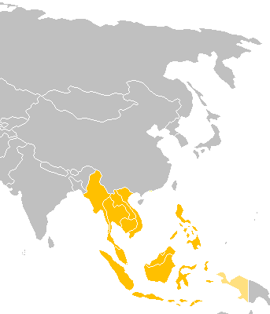
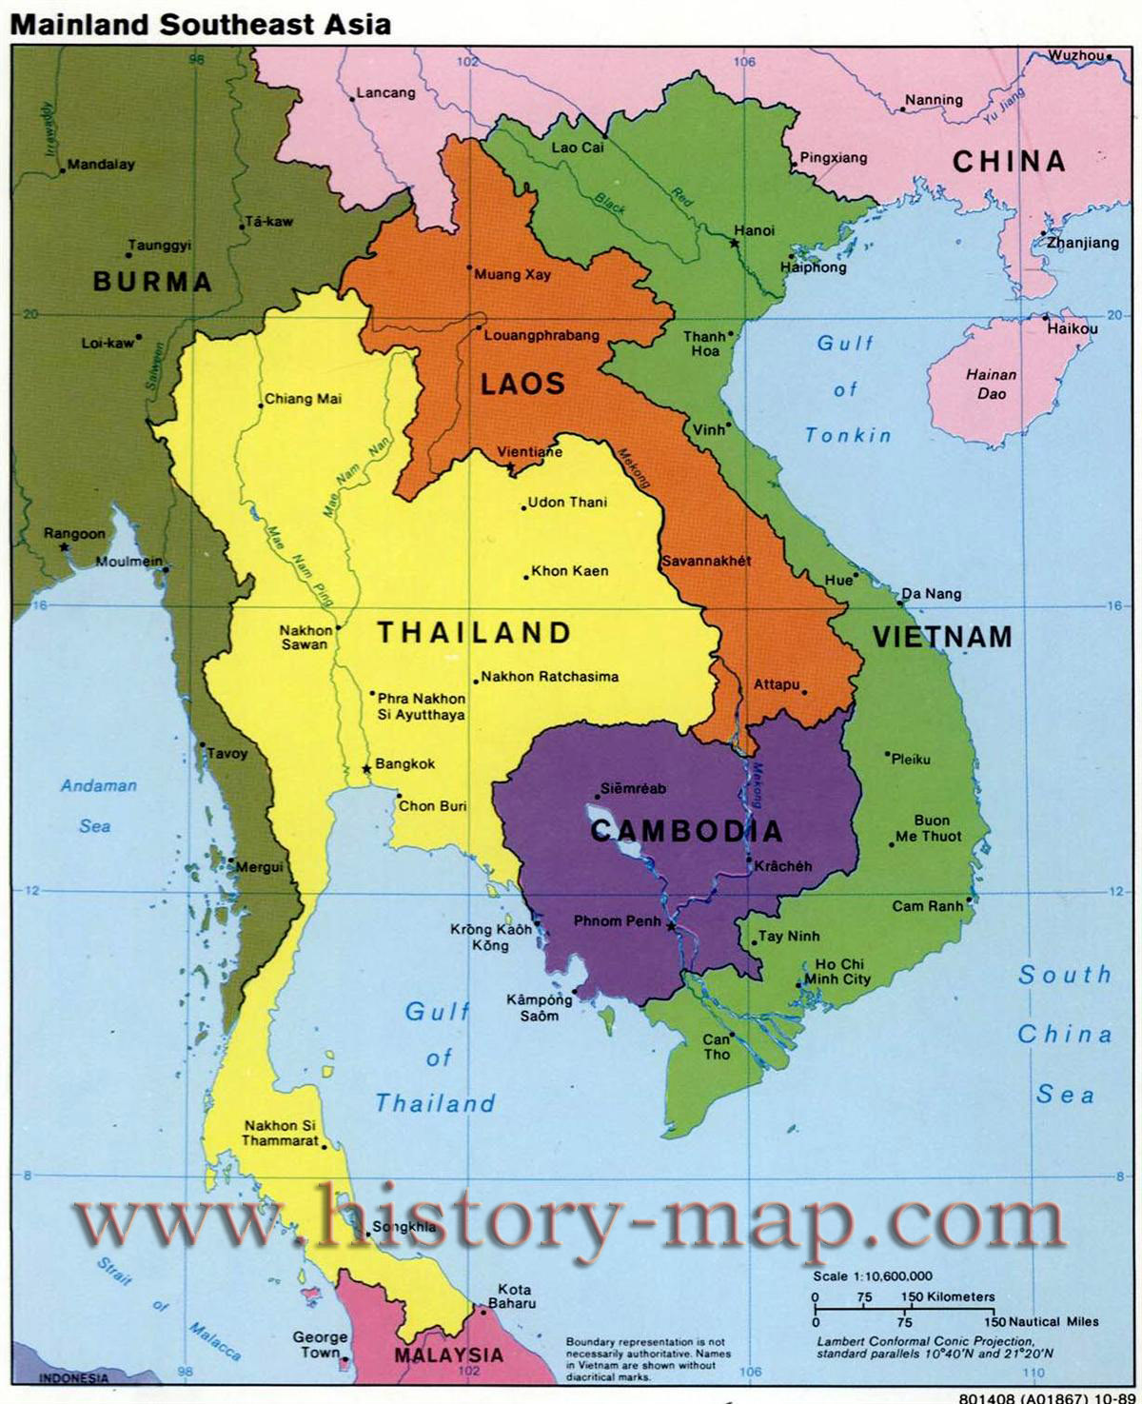
Indochina
Notes:
Surrounding Countries
Indochina

Slide 3
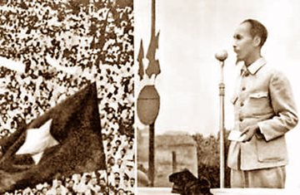
Vietnam Declares Independence in 1945

Slide 4
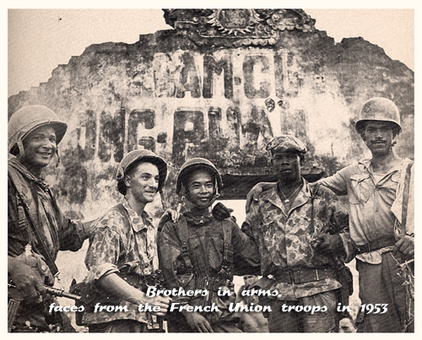
The Vietminh and France Fight the First Indochina War from 1946 to 1956
Notes:
1945 – Vietnamese Dec of Independence, France not Happy
1946 – First Indochina War –Vietminh vs. France in Cambodia and Vietnam
1950 – US sends Aid to French (Domino Theory)

Slide 5
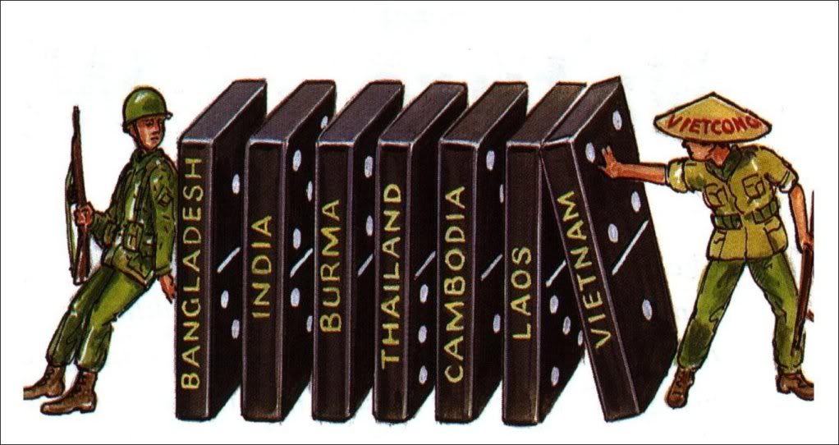
The US and USSR Take Sides, Domino Theory Gains Traction

Slide 6
Between the Wars
1954 – French Surrender
1954 – Geneva Accords, Partition at 17th Parallel
1956 - US Backs South Vietnam and Ngo dinh Diem
Notes:
1954 – French Surrender to Ho
1954 – Geneva Accords Signed, 17 Degrees Line, US sets up Govt. in South
Ngo dihn D’Yem – US supported dictator, cancels elections

Slide 7
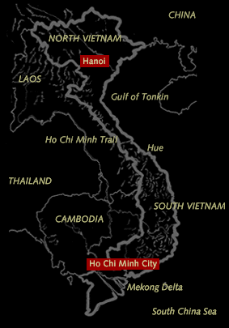
Vietnam
Ho Chi Minh City (Saigon)
Hanoi
Gulf of Tonkin
Notes:
Ho Chi Minh City (Saigon)
Hanoi
Gulf Of Tonkin

Slide 8
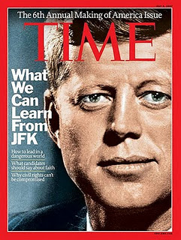
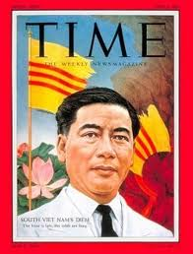
Assassination
1963
John F. Kennedy
Ngo dihn D’Yem
Notes:
1963 Ngo dihn D’Yem overthrown by generals, assassinated, US begins sending troops
1963 Kennedy assassinated, LBJ takes over
16,000 Troops in Vietnnam

Slide 9
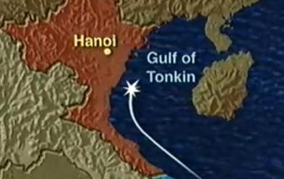
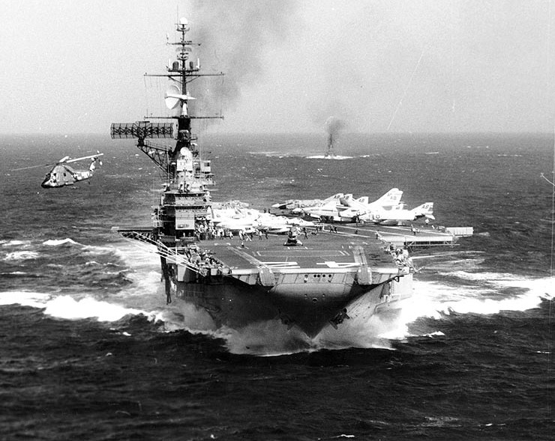
Gulf Of Tonkin
August 2, 1964
USS Maddox Incident
Gulf of Tonkin Resolution
Notes:
Gulf Of Tonkin 1964 – Big Issue

Slide 10
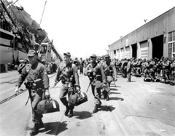
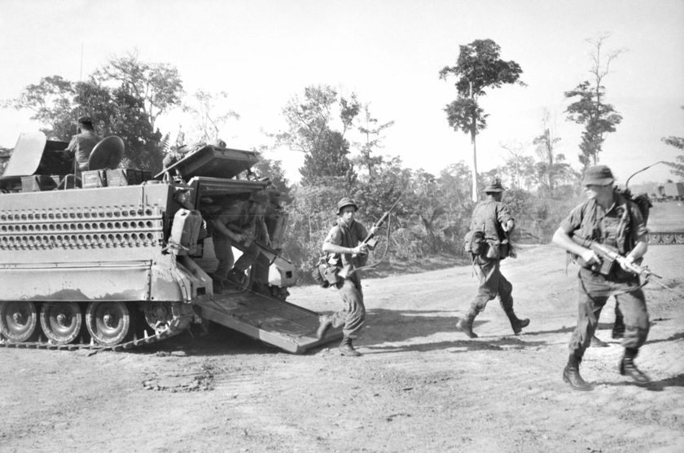
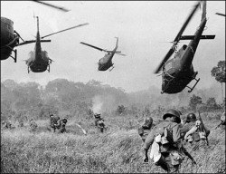
Vietnam Timeline
1964 – 23,300 US Troops
1967 – 485,600 US Troops
Notes:
1964 – 23,300 US Troops in country
1967 – 485,600 US Troops

Slide 11
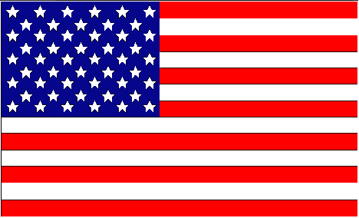
The Combatants
United States (US) South Vietnam / Republic of Vietnam (ARVN) | National Liberation Front (NLF) /Viet Cong (VC) North Vietnam (NVA) / People’s Army of Vietnam (PAV) People’s Republic of China (PRC)
Notes:
Vietcong – People’s Liberation Front – Tet Offensive – 1968

Slide 12
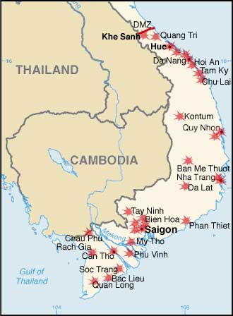
Tet Offensive
1968

